Slide 1
WORKSHOP ON “QUANTITATIVE GENETICS AND GENOMICS IN PLANT BREEDING”
23rd-27th November 2020
Organised by
Department of Biotechnology, VIGNANS University for science, Technology and Research, Guntur, AP
Tutors :
Dr. Sujan Mamidi
Dr. Divyashree Nageswaran

Slide 2
DAY 1: 23.11.2020
My Introduction & Research journey
PART I

Slide 3
Meiosis
Recombination takes place during Meiotic prophase I
End of Meiosis I, one replicated homologous chromosome per daughter cell
Haploid (n) gametes at the end of Meiosis II
Mercier et al. 2015
Notes:
About meiosis and mitosis

Slide 4
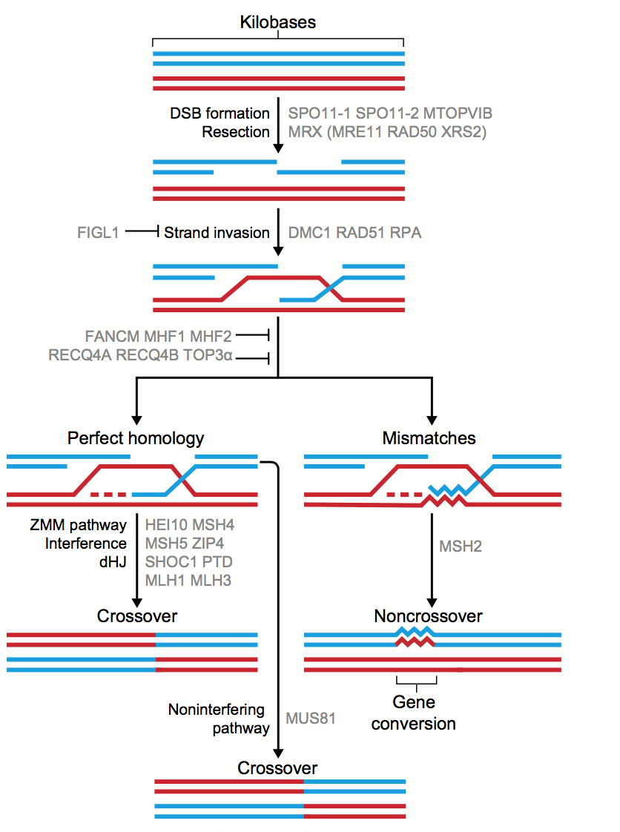
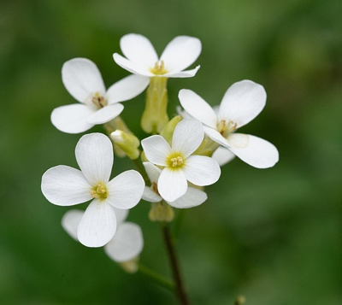
Meiotic Recombination in Arabidopsis
250
https://libraries.mit.edu
10
https://www.eurekalert.org
Ziolkowski et al.,2017
~2 CO/Chr

Slide 5
PhD work
A forward genetic screen to identify genes that control meiotic recombination in Arabidopsis thaliana
Why this project?

Slide 6
A forward genetic screen to isolate mutants that display higher or lower recombination rate (cM)
Melamed-Bessudo et al. 2005; Wu et al. 2015; Francis et al. 2007; Berchowitz and Copenhaver 2008.
Allen et al.2013
unpublished

Slide 7

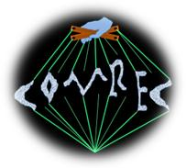


Acknowledgements
Ian Henderson (PhD Supervisor)
Kyuha Choi (former postdoc, collaborator) from Pohang University, South Korea
Christophe Lambing (cytology)
Heidi Serra (collaborator)
Xiaohui Zhao (Bioinformatics)
Bruno Santos (Bioinformatics)
Andy Tock (Bioinformatics)
Liliana (PGF technician)
Mel (PGF technician)
Pablo Parra & Monica Pradillo from Complutense University, Spain, COMREC member (Immunocytology)
Kim Osman & Chris Franklin (Antibodies, COMREC member)
Avraham Levy (Seed FTLs)
Gregory Copenhaver (Pollen FTLs)
Peter Schlogelhofer (PhD Examiner, University of Vienna, COMREC member)
COMREC Marie Curie ITN

Slide 8
PART II
Few Concepts in Genetics
To refresh !!!!

Slide 9
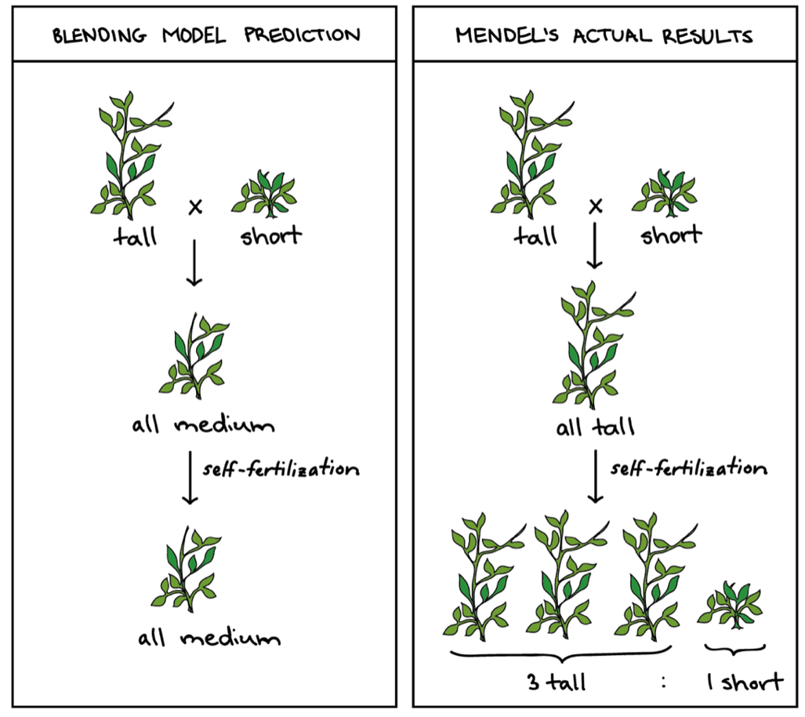
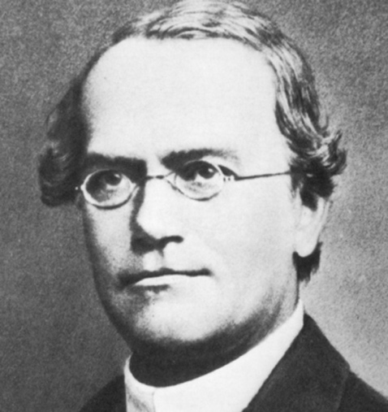
Mendel’s laws of Inheritance
Law of dominance
When two homozygous individuals with (TT & tt) one or more (RRYY & rryy) sets of contrasting traits are crossed, the visible characters in the F1 hybrids are dominant and those which do not appear are recessive.
Johann Gregor Mendel (1822-1884)
Khan academy
Notes:
Worked 8 long years on Pisum sativum/pea – a good model by raising a large population.
Wanted to understand how traits/characters are transferred from one generation to another - hence framed “principles of heredity”
“Law of dominance” - meticulously counting peas, termed “dominant” and “recessive”.
Identified 7 different characters in peas but single gene- he didn’t deal with quantitative characters.
Used statistical methods to analyze and predict inheritance.
“Law of segregation or purity of gametes” - Mendel wanted a hybrid crossing white and purple – mix of both but he got only one of the gene copies or alleles/phenotypes – law of segregation and that happens in sex cells.
Identical copies of two factors – homozygous or else het. Alternative forms of a factor called an allele. An individual’s phenotype is determined by genotype or allele and environment.
“Law of independent assortment” - For each trait, an individual possesses two alleles – one given by female parent and another by male parent.

Slide 10
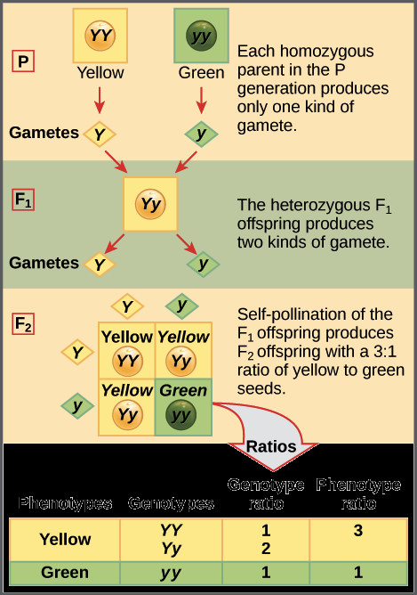
2. Law of segregation / Purity of gametes
Only one of the two copies (YY & yy) of the factors or genes enters each gamete (egg or sperm cell) and this allocation is random.
During fertilization, gametes unite to produce F₁ . F₁s are heterozygotes with one gene of Y and y.
When F₁ undergo fertilization (Yy x Yy) , two types of gametes are formed with each gene having 50 %. All possible combinations occur in F₂ when gametes unite at random.
Khan academy

Slide 11
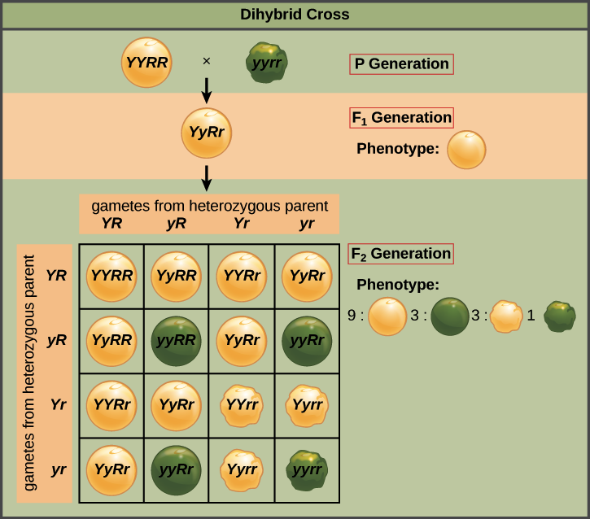
3. Law of Independent assortment
Alleles of two or more different genes for each pair of traits/characters assort out independently into gametes of the other pairs.
Allele of one gene received by the gamete does not influence the allele of another gene.
Dihybrid cross ratio – 9:3:3:1 (phenotypic ratio)
Test cross in F₂ (F₁ x recessive P₂) to confirm ratio as 1:1:1:1.
Dihybrid cross is an example
Khan academy

Slide 12
Alleles may not assort independently at different loci
Reasons:
Either by chance/probability
Linkage – genes/alleles at different loci on the same chromosomes are very close together
Law of independent assortment was framed before we knew “meiosis”.

Slide 13
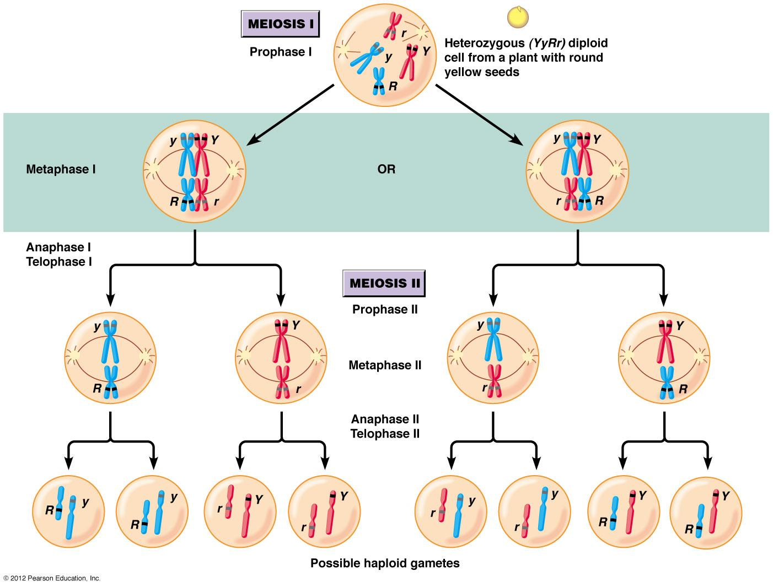
What happens during meiosis?
Haploid gametes are formed from diploid cells.
- Independent Assortment of genetic loci
Takes place on different chromosomes
2. Also takes place on the same chromosome if the genes/loci are far apart via crossover/recombination.
enotes.com

Slide 14
Linkage and Crossing over
Linkage
Genes on the same chromosome are linked and they fail to assort independently
Such genes segregate together in a population.
Linkage is based on the frequency of crossing over between the two genes.
Crossing Over/recombination
Reciprocal exchange of chromosome segments between homologs (non-sister chromatids)
This exchange of DNA/Chr segments is during meiosis I – prophase – stage pachytene.
Promotes genetic variation and reduces linkage , hence is highly useful to plant breeders.
https://ib.bioninja.com.au/
Notes:
Chromosome mis-segregation occurs due to reduced or absent recombination, kinetochore bi-orientation, defective spindle assembly checkpoint (SAC) or deterioration of sister chromatid cohesion during meiosis I, which may cause gamete or foetal aneuploidy due to loss or gain of chromosomes.

Slide 15
Linkage map
Called genetic map or chromosome map too.
Linkage map – A map based on recombination frequencies between genetic markers during a crossover/recombination of homologous chromosomes during meiosis.
Recombination frequency/crossover rate/genetic distance (cM) is a measure of CO or recombination between two genes that indicates how much recombination is observed in a particular experiment.
The greater the frequency of recombination between two markers, the farther they are apart.
The map distance or genetic distance (cM) between two genes equals one half the average number of crossovers in that region per meiotic cell
Modified from Dr.Sujan Mamidi

Slide 16
Linkage map
Applications/uses:
Map based cloning/ positional cloning – method by which genetic basis of a mutant phenotype or variation is identified by finding for linkage to markers whose physical location in the genome is known.
Identify genes conferring traits of interest
Estimating gene effects of essential agronomic traits in crops
Tagging genes of interest in facilitating marker-assisted selection (MAS) programs in breeding.
- Useful in studying genome structure, organization and evolution.
Modified from Dr.Sujan Mamidi

Slide 17
Genetic Linkage Mapping steps
Developing Mapping Population
Genotyping mapping population using molecular markers
Linkage analysis (calculating RF)
Constructing genetic map
QTL mapping
Marker-assisted selection
Courtesy : Dr.Sujan Mamidi

Slide 18
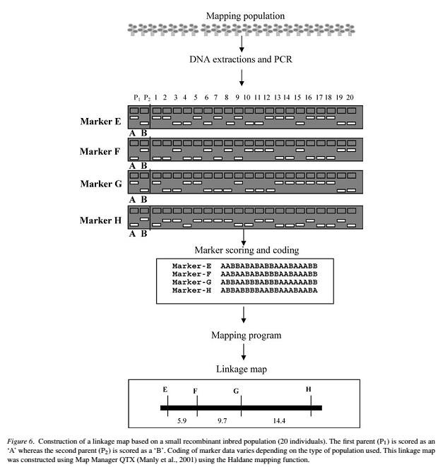
Courtesy : Dr.Sujan Mamidi

Slide 19
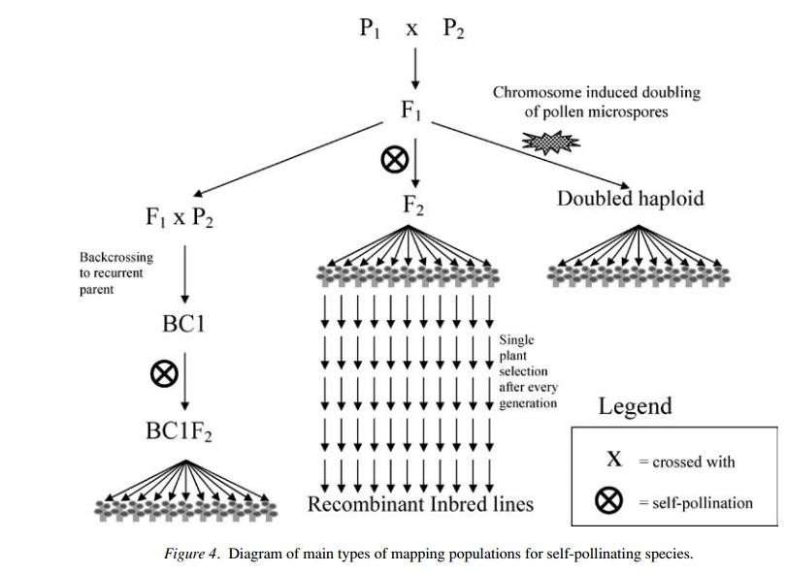
Developing Mapping Population
Courtesy : Dr.Sujan Mamidi

Slide 20
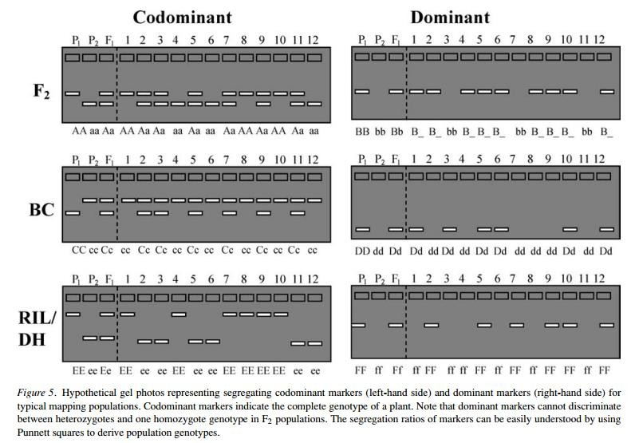
Molecular markers
RAPD
RFLP
AFLP (PCR & RFLP)
SSR (microsatellite polymorphic markers)
SNP (transitions/transversions)
CAPS/dCAPS
(for SNP detection)
Modified from Dr.Sujan Mamidi
Notes:
- Restriction Fragment Length Polymorphism (RFLP)
is a difference in homologous DNA sequences that can be detected by the presence of fragments of different lengths after digestion of the DNA samples in question with specific restriction endonucleases. RFLP, as a molecular marker, is specific to a single clone/restriction enzyme combination.
Most RFLP markers are co-dominant (both alleles in heterozygous sample will be detected) and highly locus-specific.
- Amplified Fragment Length Polymorphisms (AFLPs)
are differences in restriction fragment lengths caused by SNPs or INDELs that create or abolish restriction endonuclease recognition sites.
The AFLP technique is based on the selective PCR amplification of restriction fragments from a total digest of genomic DNA.
SSR- simple sequence repeats -even 10 alleles per locus are found- highly polymorphic
RAPD- Random amplified polymorphic DNA – random segments are amplified using a single primer of arbituary nucleotide sequence.
CAPS/dCAPS- Cleaved Amplified Polymorphic sequences – detect SNPs –locus specific and sequence specific markers- Cleaved polymorphisms are differences in restriction fragment lengths caused by SNPs or INDELs that create or abolish restriction endonuclease recognition sites in PCR amplicons produced by locus-specific oligonucleotide primers.
How It Works- The CAPS assay uses amplified DNA fragments that are digested with a restriction endonuclease to display RFLP.
- dCAPS - Derived Cleaved Amplified Polymorphic Sequences (dCAPS)
assay is a modification of CAPS (or alternatively, PCR-RFLP) technique for detection of Single Nucleotide Polymorphisms (SNPs). In dCAPS assay a mismatches in PCR primer are used to create restriction endonuclease (RE)-sensitive polymorphism based on the target mutation. This technique is useful for genotyping known mutations and genetic mapping of isolated DNAs.
How It Works- The dCAPS technique introduces or destroys a restriction enzyme recognition sites by using primers that containing one or more mismatches to the template DNA. The PCR product modified in this manner is then subjected to restriction enzyme digestion and the presence or absence of the SNP is determined by the resulting restriction pattern.

Slide 21
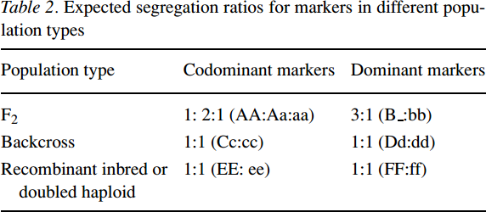
Marker segregation ratios for different populations
Courtesy : Dr.Sujan Mamidi

Slide 22
Advantages of Molecular markers
1. Studying evolution and phylogeny – reconstruction of genetic maps.
2. Investigation of heterosis /hybrid vigour – effect of F₁s.
3. Genotyping in populations
4. Assessment of Genetic diversity /comparative genomics
5. Utilization in backcrossing for a gene of interest
6. Linkage mapping
7. QTL mapping – locate genes of interest conferring quantitative traits.
8. GWAS - powerful technique to study the genetics of natural variations and traits of interest – millions of SNPs are produced.
9. MAS

Slide 23
NGS and GBS
Next- Generation sequencing (NGS)
Millions of SNPs are produced at low cost.
have a variety of applications – Linkage mapping, GWAS, identifying mutations etc…
Platforms provided by Illumina, Roche, PacBio etc.
Genotyping-by-sequencing (GBS)
simple and multitudinous technique for identification of SNPs.
Modernization in the NGS reduced sequencing costs, thus led to GBS for large genome species.
Provides great magnitude of SNPs for genotyping and genetic analysis.
Great for germplasm characterization, breeding of diverse crops and population studies.

Slide 24
Linkage analysis
Linkage : alleles from two loci segregate together in a family.
Recombination fraction (θ): the probability of a marker and a susceptibility locus segregating independently (recombination).
θ= 0.5 No linkage
θ< 0.5 linked together
Courtesy : Dr.Sujan Mamidi

Slide 25
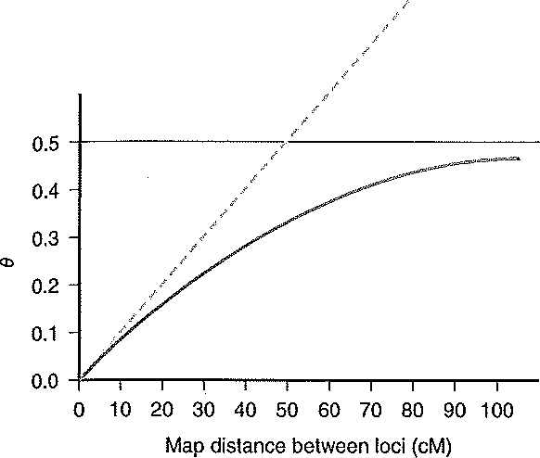
Recombination frequency
Total amount of recombinants
Ɵ =
Total amount of recombinants + Total amount of non-recombinants
Parent Gametes Theta
50% non-rec and 50% rec
0.5
A
a
90% non-rec and 10% rec
0.1
B
b
99% non-rec and 1% rec
0.01
100% non-rec
0
Courtesy : Dr.Sujan Mamidi

Slide 26
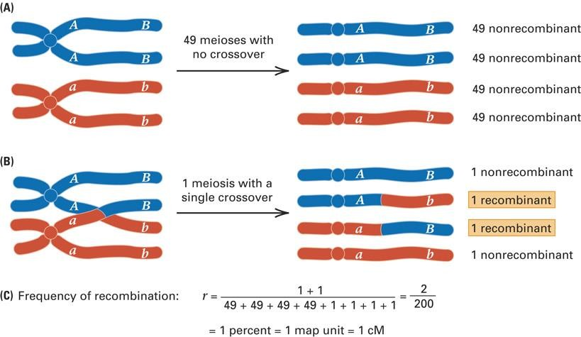
Courtesy : Dr.Sujan Mamidi

Slide 27
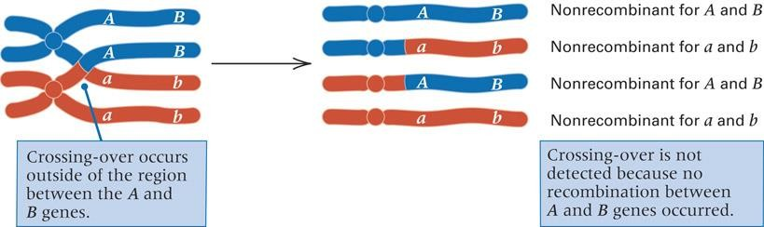
Genes with recombination frequencies less than 50 percent are on the same
chromosome = linked)
Two genes that undergo independent assortment have recombination frequency of 50 percent and are located on nonhomologous chromosomes or far apart on the same chromosome = unlinked
Courtesy : Dr.Sujan Mamidi

Slide 28
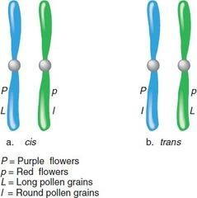
In double heterozyote:
Cis configuration = mutant alleles of both genes are on the same chromosome = ab/AB
Trans configuration = mutant alleles are on different homologues of the same chromosome = Ab/aB
Courtesy : Dr.Sujan Mamidi

Slide 29
Recombination frequency
Recombination between linked genes occurs at the same frequency whether alleles are in cis or trans configuration
Recombination frequency is specific for a particular pair of genes
Recombination frequency increases with increasing distances between genes
No matter how far apart two genes may be, the maximum frequency of recombination between any two genes is 50 percent.
Courtesy : Dr.Sujan Mamidi

Slide 30
Crossing Over /Recombination
Crossovers which occur outside the region between two genes will not alter their arrangement
The result of double crossovers between two
genes is indistinguishable from independent assortment of the genes
Crossovers involving three pairs of alleles
specify gene order = linear sequence of genes
Courtesy : Dr.Sujan Mamidi

